Slide 1





Team Fame-ous
Xavier Institute of Management, Bhubhaneswar
Gyanesh Samanta
um24348@stu.xim.edu.in
+91 8763048771
Sudhanya Dash
um24375@stu.xim.edu.in
+91 7377351886
Sumit Raichandani
um24378@stu.xim.edu.in
+91 7024359997

Slide 2




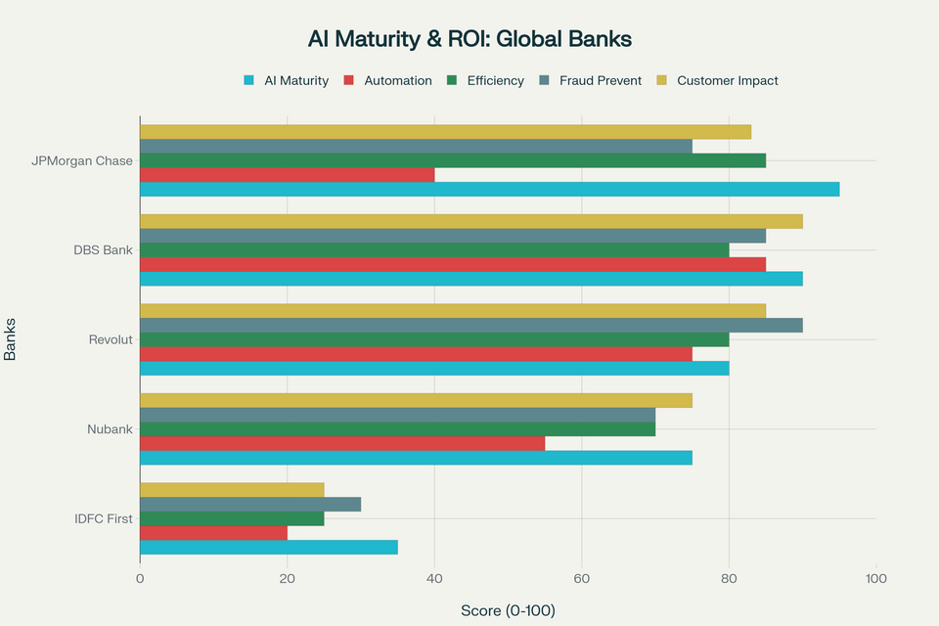





Primary Research and Executive Summary
Solution and Implementation Roadmap
Executive Summary of the Problem Statement
Customer Experience → Customer Perception → Customer Emotion → Customer Behaviour → Business Outcome
For IDFC First Bank, this represents a critical opportunity to leapfrog competitors through strategic AI adoption. The bank's recent financial performance shows strong deposit growth of 25.2% year-over-year to ₹2,42,543 crore as of March 31, 2025, providing a solid foundation for technology investment. However, the 48.4% decline in net profit to ₹1,525 crore in FY25 underscores the urgency for operational efficiency improvements and enhanced customer experience differentiation.
Primary Research - User Persona’s in India unsatisfied with Customer Experience in Banking
AI Maturity of Global Banks
Rajesh Verma | Age: 42 | Small Business Owner
Priya Sharma| Age: 28 | Working Professional
Profile: Rajesh runs a small retail store in Indore. He uses digital banking mainly for checking balances and simple transfers.
Profile: Riya is a consultant living in Mumbai. She uses digital banking daily for UPI, bill payments, and tracking expenses.
Pain Points:
Chatbots often give generic replies and waste time.
Complex queries still require branch visits.
Trust issues with fully automated support.
Needs & Preferences:
Reliable AI support that resolves issues directly.
Human-agent escalation for complex problems.
Local language interface (Hindi preferred).
Assurance of security and trustworthy digital service.
Pain Points:
Banking apps feel generic and not personalized.
Too much manual searching for features.
No proactive reminders for EMIs or low balance.
Needs & Preferences:
AI-powered assistant for instant, contextual answers.
Personalized nudges: savings tips, EMI reminders, budget alerts.
Premium, “know-me” experience
Secondary Research - Research Papers from Journals around B2C Customer Experience
Key Takeaways
Research Paper Title: AI-Powered Personalization in Digital Banking (2025, American Journal of Interdisciplinary Studies)
Research Paper Title: AI in Financial Customer Relationship Management (2025, AJATES)
Reliable AI with human backup; Hindi/local languages; strong security; smart UPI/bills/EMI/budget nudges
Personalization lifts efficiency and service quality; builds emotional loyalty and lifetime value
Chatbots cut response time 57% and costs 38%
Retention +28%; adoption +31%; CLV +27%; keep humans for complex cases with strict privacy and governance
Methodology: Review of 111 research articles (2014–2024)
Methodology: Systematic review of 83 studies and case evidence
Key Insights for Customer Experience in B2C:
Personalization boosts efficiency, service quality, and emotional loyalty → higher customer lifetime value.
Techniques like ML, NLP, and sentiment analysis create tailored digital journeys.
Key challenge: privacy and governance risks need careful handling.
Key Insights for Customer Experience in B2C:
Chatbots cut response time by 57% and costs by 38%, boosting efficiency.
Retention rose 28%, adoption 31%, and CLV 27% — clear ROI.
Caution: bots can’t fully replace human support for complex needs.
AI that remembers, service that cares.

Slide 3
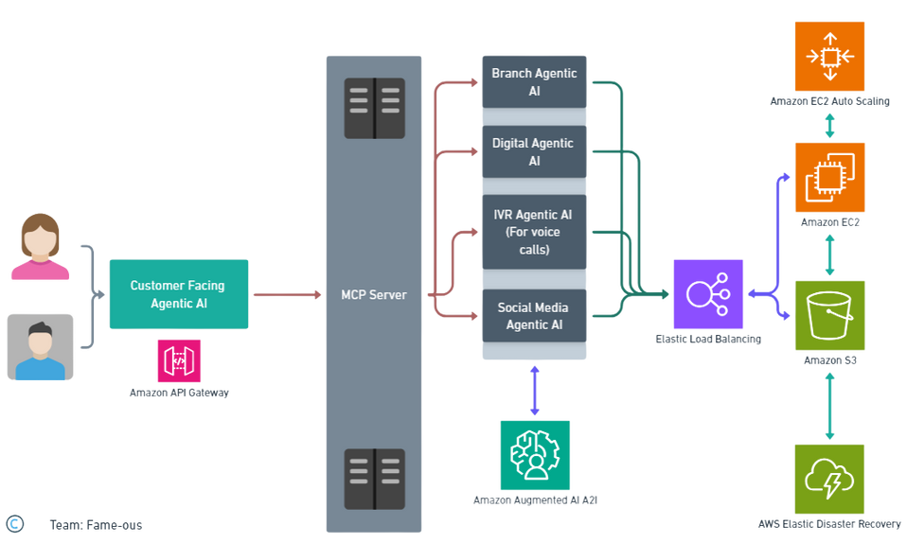

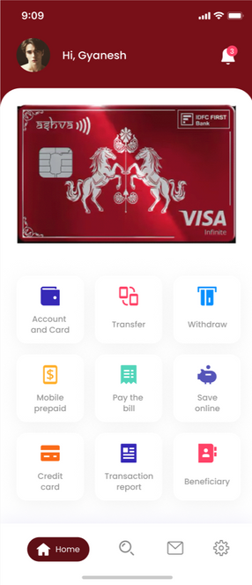

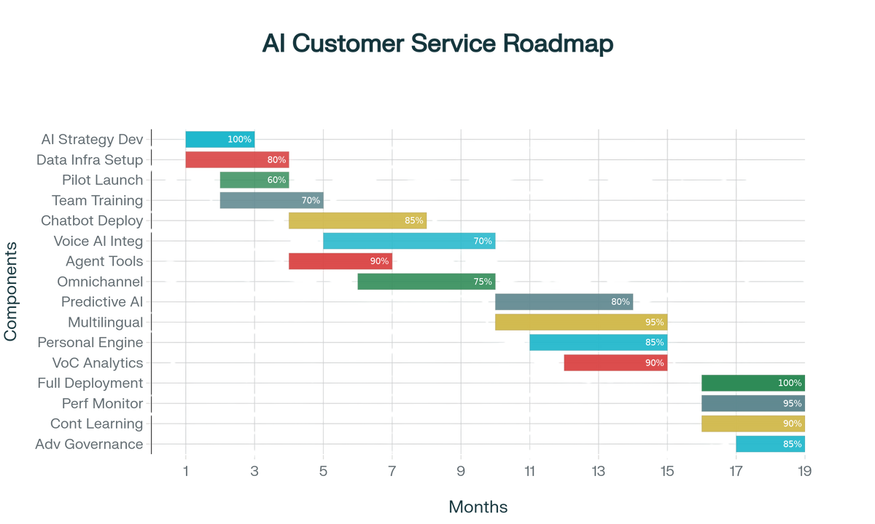



Primary Research and Executive Summary
Solution and Implementation Roadmap
What is Agentic AI as an Omni-channel Offering?
Agentic AI in Social Media and Call Center
Agentic AI as an Omni-channel Offering - Tech Architecture
Agentic AI as a single brain for every channel - app, web, WhatsApp, branch, and call centre - that understands intent in 22+ Indian languages with 95% accuracy, carries context across touchpoints, takes the next best action in real time, and keeps learning - making it the world’s most complete, high‑impact customer service solution for IDFC First.
Social media
WhatsApp Business and Instagram bots answer in under 30 seconds
Social-listening engine spots sentiment spikes and trends
Automatic hand-off to human agent when confidence < 80% with context preserved
Overview of the Tech Architecture
Agentic AI in Digital and Branch
Digital (mobile/Web)
FIRST Genie virtual assistant, 24 × 7, 22 Indian languages, 95% intent accuracy
Handles 84% of urban banking tasks inside the app
Instant UPI payments with voice or chat commands
Proactive spend alerts and personalised nudges
Call centre
Answers 95% faster; AHT –20%
Real-time emotion cues with coaching tips
100 + accent recognition and smart routing
Agentic AI as an Omni-channel Offering - Roadmap
Financial Projections
Based on today’s volumes and unit costs, with savings from 70–85% automation and 20% lower agent AHT.
Revenue gains from personalization (cross‑sell and retention), with phased build‑scale‑optimize spend and break‑even by month 14.
Branch
Relationship managers receive real-time customer insights
Biometric check-in and AR navigation for quicker service
Smart queue predicts wait time and routes customers
Months
For detailed projections and ROI refer to the google sheet in the appendix section

Slide 4
Appendix
Secondary and Other Research
https://www.researchgate.net/publication/390492933_AI-POWERED_PERSONALIZATION_IN_DIGITAL_BANKING_A_REVIEW_OF_CUSTOMER_BEHAVIOR_ANALYTICS_AND_ENGAGEMENT
https://www.researchgate.net/publication/388893812_Artificial_Intelligence_in_Financial_Customer_Relationship_Management_A_Systematic_Review_of_AI-Driven_Strategies_in_Banking_and_FinTech
https://useinsider.com/omnichannel-banking-customer-experiences/
https://coinlaw.io/ai-in-banking-statistics/
https://convin.ai/blog/ai-in-banking-examples
https://www.desk365.io/blog/ai-customer-service-statistics/
https://www.finextra.com/blogposting/28841/ai-becomes-the-banker-21-case-studies-transforming-digital-banking-cx
https://brand24.com/blog/customer-service-kpis/
https://tearsheet.co/artificial-intelligence/how-dbs-bank-uses-a-human-ai-synergy-approach-to-enhance-customer-experiences-and-improve-efficiencies/
https://ijsret.com/wp-content/uploads/2024/01/IJSRET_V10_issue1_138.pdf
https://www.cloud-kinetics.com/blog/microservices-based-application-modernization-for-open-banking/
https://www.pib.gov.in/PressReleasePage.aspx?PRID=2155543
Financial and ROI Projections
https://docs.google.com/spreadsheets/d/1Z6W6aJoabLQzX8pobVEX54FNPDL14eQjw85DDty2Hzc/edit?usp=sharing
https://ijsra.net/sites/default/files/IJSRA-2024-0639.pdf
https://www.ijfmr.com/papers/2023/6/11192.pdf
https://journalajeba.com/index.php/AJEBA/article/view/1768
https://shanlaxjournals.in/journals/index.php/management/article/download/7134/6412

